Slide 1



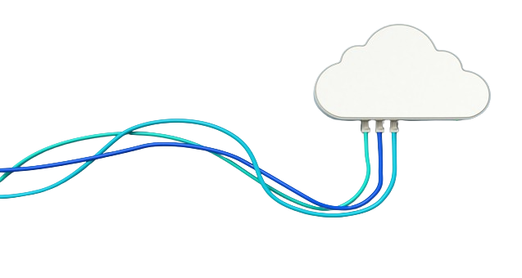

Azure Cloud Solution Admin & Architect
zure

Slide 2


Team Members
Mohamed Sarhan El-hussieny
Ismail Sabry Attwa
Haytham Mohamed
Ahmed Ibrahim Saad
Abdel-Azizi Fouad
Essam Abdo Hassan
Supervised by:
Eng. Omar Hussien

Slide 3
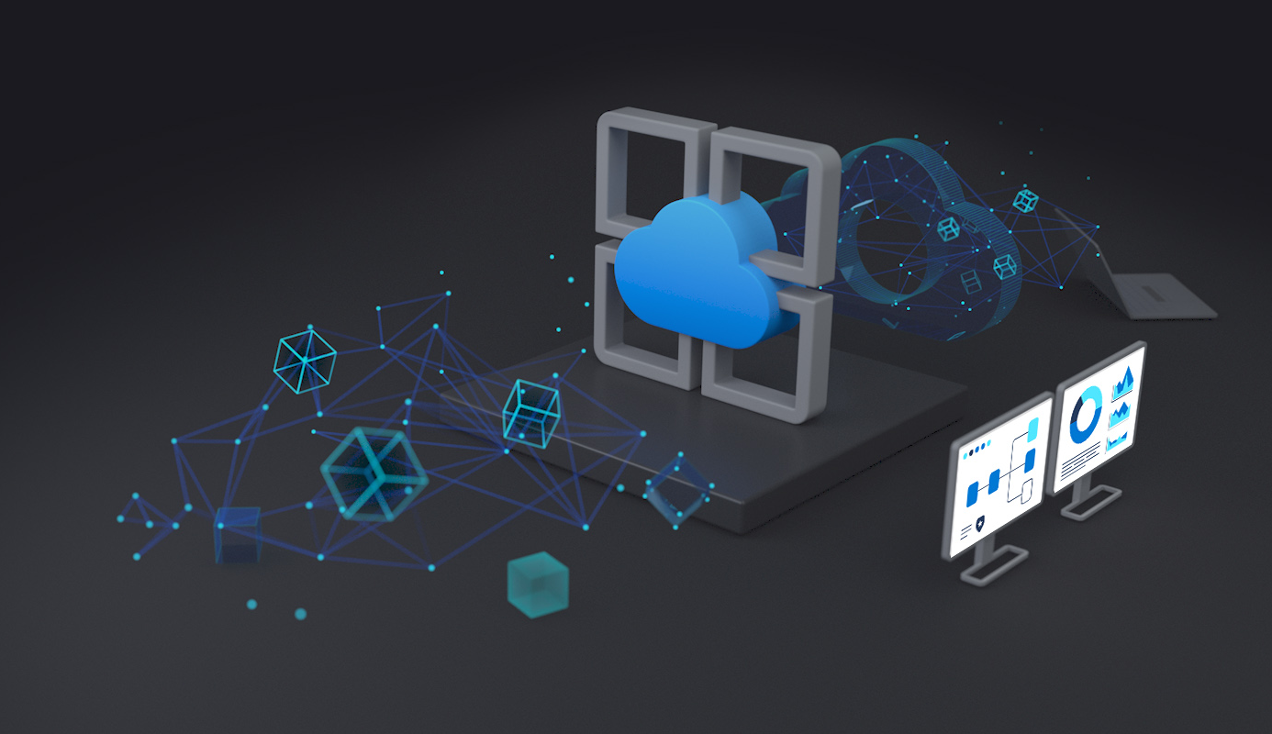
Project
Overview
This project demonstrates a full-scale Azure cloud infrastructure deployment for a web app using secure and scalable practices, focusing on efficient VM management, networking, storage, and application hosting.
Components Deployed:
2-Virtual Machines (VMs) with Active Directory and IIS.
Storage, backup, database setup, and load balancing.

Slide 4
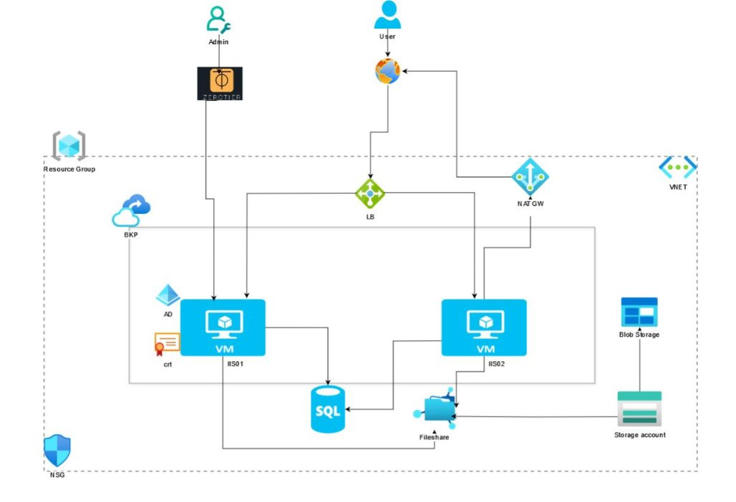
The Full Diagram of the project

Slide 5


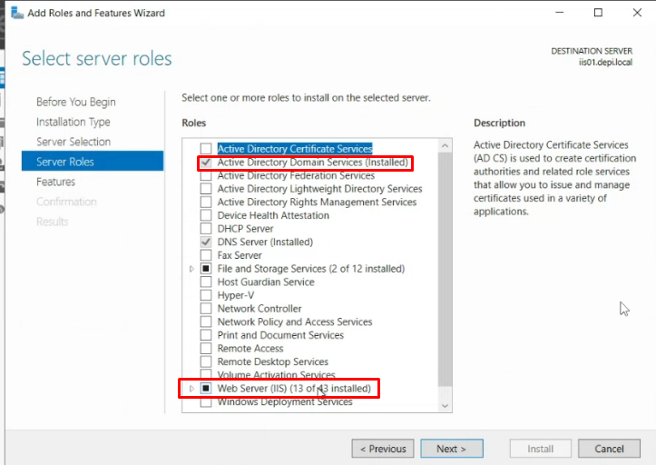
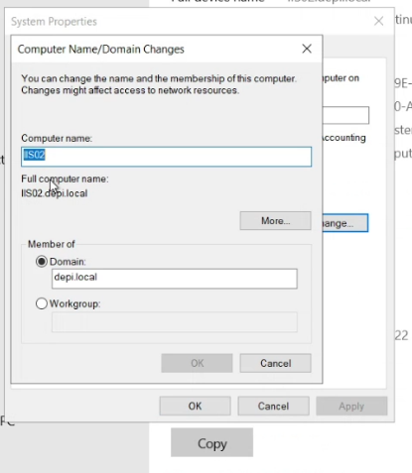
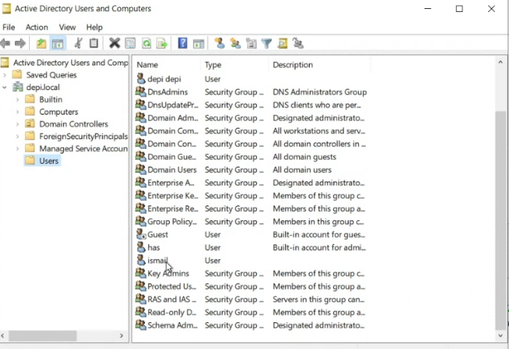
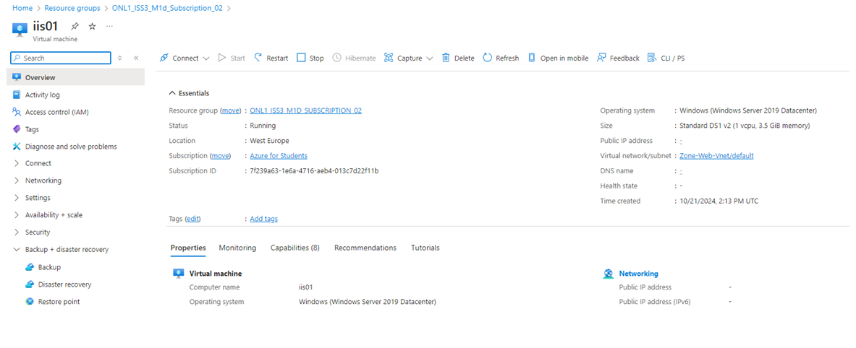
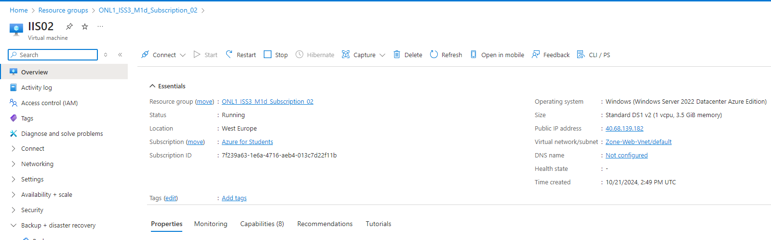
Virtual Machines and Active Directory Configuration
Virtual Machine Deployment:
Configuration: Both VMs deployed within the same Virtual Network (IIS01-vnet) in the West Europe region.
Operating System: Each VM is running Windows Server 2022 with IIS pre-installed for web services.
Domain Configuration:
Domain Controller: IIS01 has been promoted to Domain Controller under the domain (depi.local).
Domain Membership: IIS02 successfully joined the domain, ensuring centralized management and security policies across VMs.

Slide 6
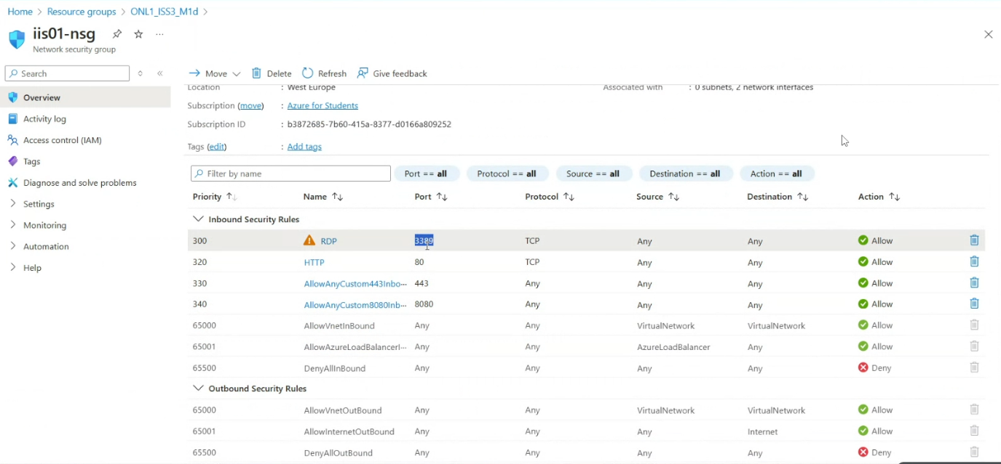
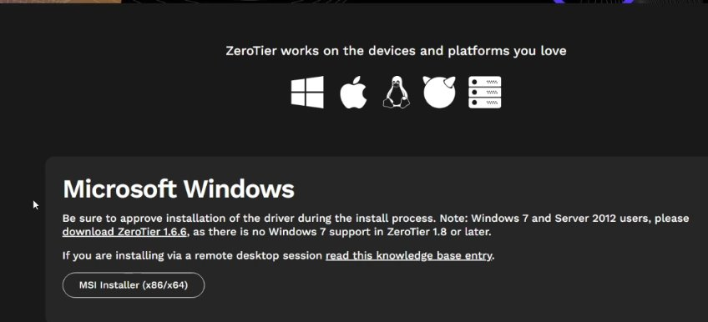
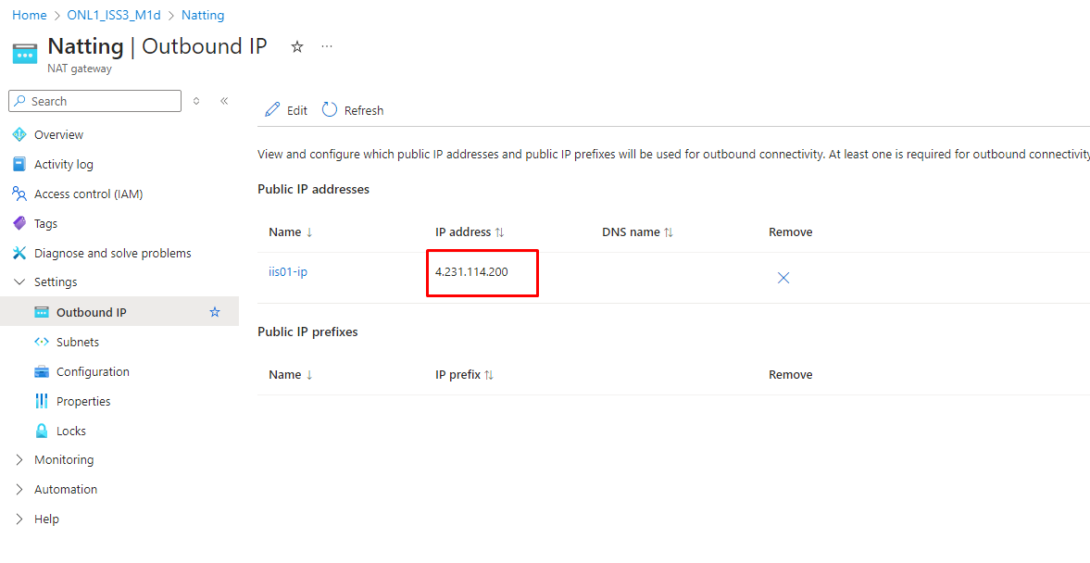
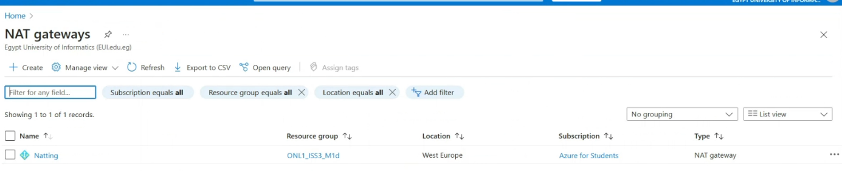
Network and Security Setup
NAT Gateway:
Purpose: Configured to optimize public IP usage, providing internet access to both VMs while maintaining efficient resource utilization.
Network Security Group (NSG):
Configuration: Applied to both VMs, enabling defined inbound and outbound traffic rules for enhanced security and controlled network access.
Remote Access via ZeroTier:
Alternative Solution: Utilized as a cost-effective, secure, peer-to-peer alternative to Azure Bastion for remote access, reducing expenses without compromising secure connectivity.

Slide 7
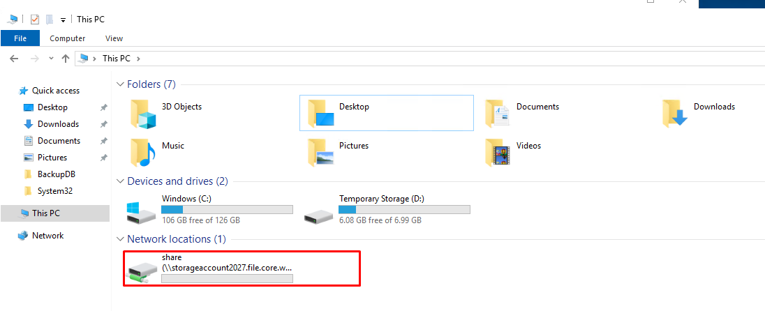
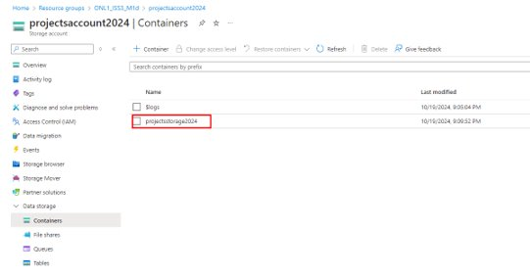
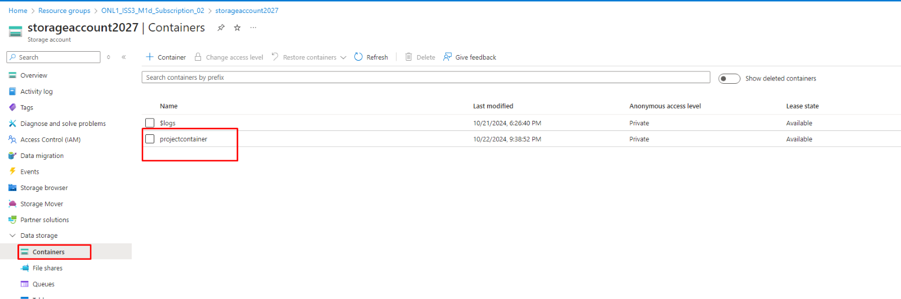
Storage Solutions
Storage Account Configuration:
Account Name: ProjectsAccount2024 with Blob storage container for optimized, scalable storage.
File Share Setup:
Configuration: Created and mapped to both virtual machines, enabling seamless data accessibility across VMs.
Data Access Control:
Access Method: Shared Access Signature (SAS) URL for controlled file-sharing access.
Access Tier:
Configured with the Hot Access Tier for high-frequency data access and quick retrieval.

Slide 8
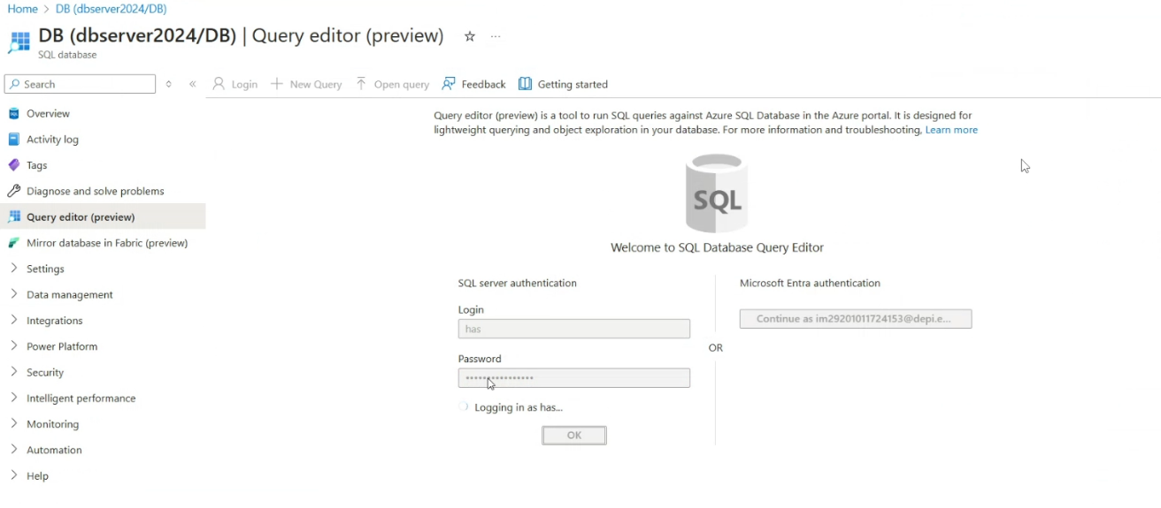
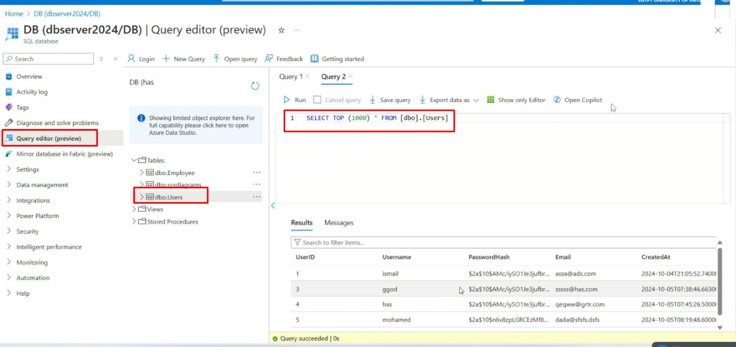
Database Deployment
Azure SQL Database:
Deployed SQL Server with a dedicated Users table for structured data storage.
On-Premises SQL Server:
Configured SQL Server 2022 with automated daily backups for enhanced data protection and continuity.

Slide 9
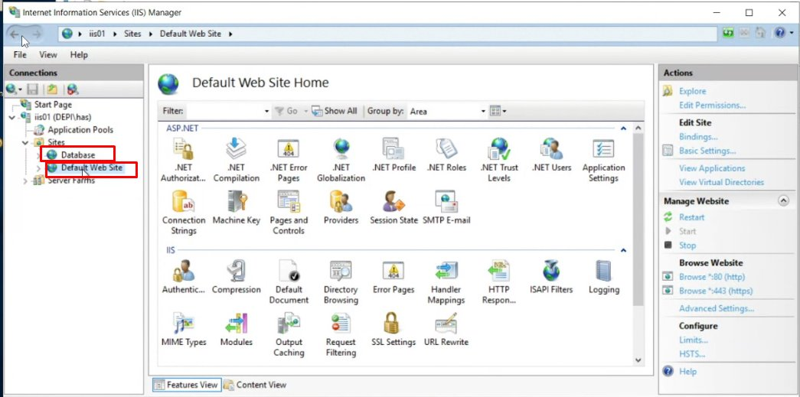
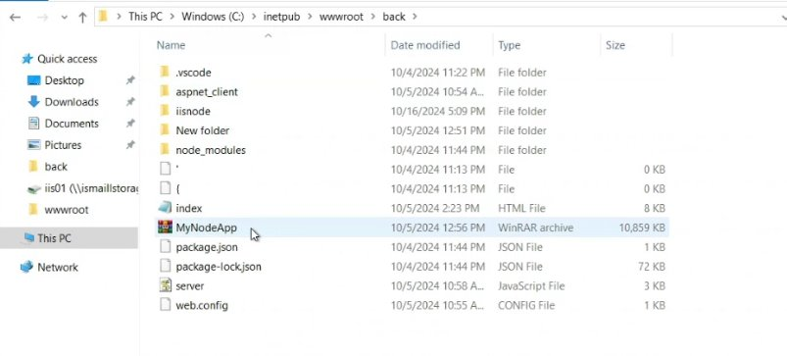
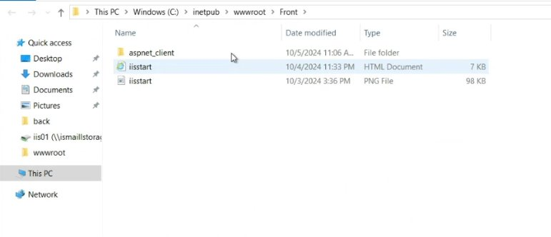
Web Application and Security Integration
3-Tier Architecture:
Frontend (IIS): User-facing layer hosted on IIS, providing the application interface.
Backend (Node.js): Logic layer where Node.js handles requests, linking frontend to the database.
Database: Centralized data management, accessed by the backend.
SSL Security:
Configured with a 90-day certificate through Certify app for secure access.
IIS Sites:
Two distinct sites hosted on IIS01, supporting both frontend and backend services.

Slide 10
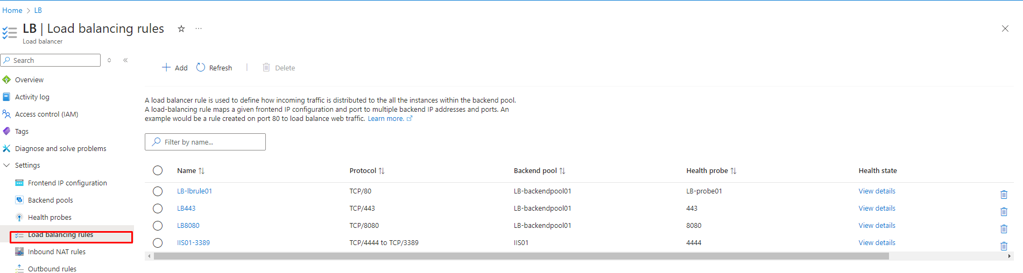
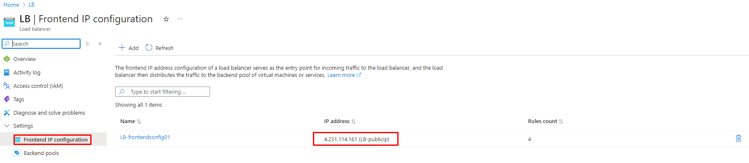
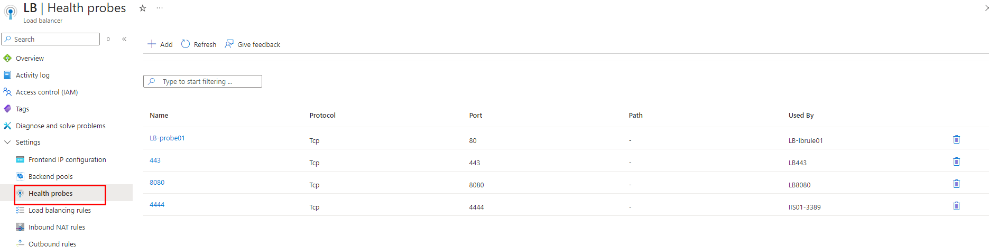
Load Balancer and Health Monitoring
Load Balancer Setup:
Frontend IP: Configured to manage incoming traffic, directing it to the designated resources.
Backend Pool: Includes specific VMs to balance loads effectively and enhance performance.
Health Probes: Monitors the health of backend resources continuously, ensuring high availability and reliability.
Access Overview:
Provides secure entry points to both the frontend interface and backend services.
Designed to ensure seamless connectivity and optimal performance, leveraging Azure's robust load-balancing capabilities.

Slide 11
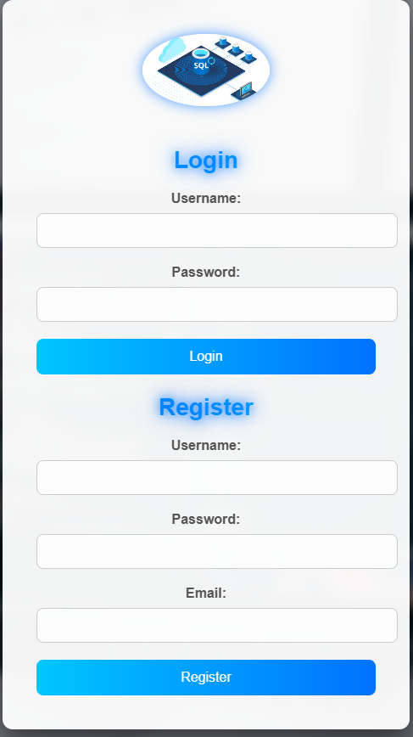
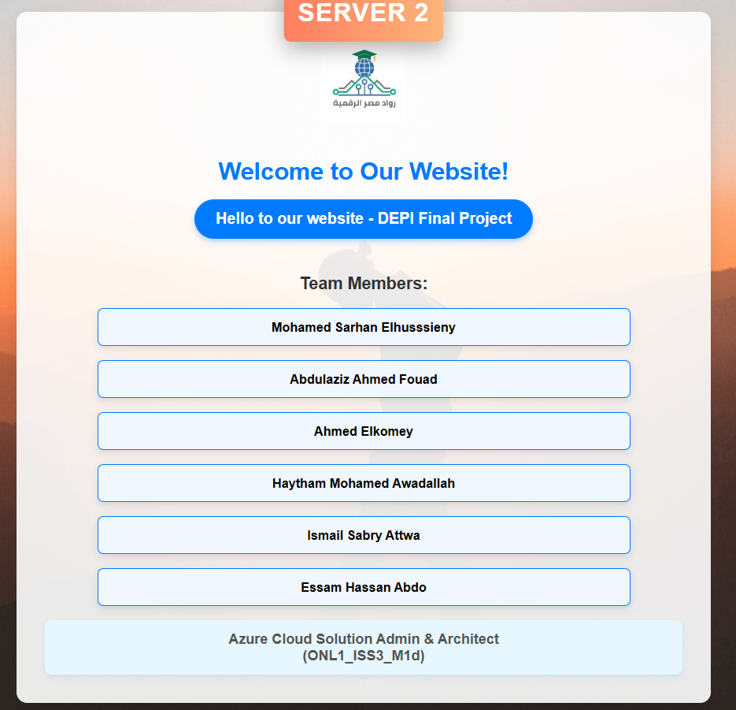
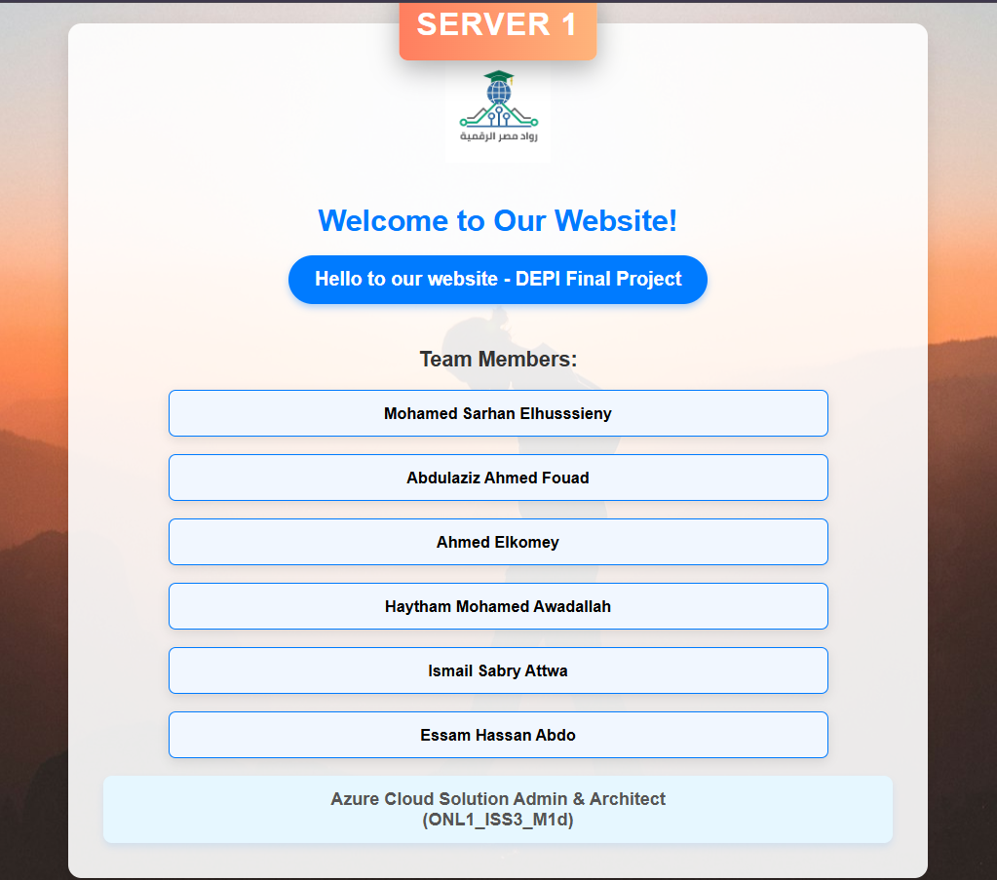
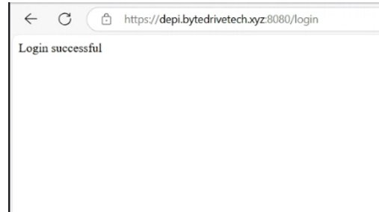
Web Interface Snapshot

